Slide 1
Recommender Systems in Context

Slide 2
Use case: Facebook
Facebook’s average data set for CF has 100 billion ratings, more than a billion users, and millions of items. In comparison, the well-known Netflix Prize recommender competition featured a large-scale industrial data set with 100 million ratings, 480,000 users, and 17,770 movies (items).
Facebook survives on an active user base, so it makes sense to keep it’s user base energized and active
Facebook implements recommender systems to recommend groups or other items that match to its users

Slide 3
How did they implement it?
Recommendation Technique: Chose Collaborative filtering (CF) technique that helps people discover items that are most relevant to them. At Facebook, this might include pages, groups, events, games, and more. CF is based on the idea that the best recommendations come from people who have similar tastes.
Processing Framework: Apache Giraph is an open source Apache foundation project. It works extremely well on massive data sets, and it is easily extensible. Therefore, Giraph was an obvious choice for this problem.

Slide 4
Implementing CF
Matrix Factorization: A common approach to CF is through matrix factorization, in which we look at the problem as having a set of users and a set of items, and a very sparse matrix that represents known user-to-item ratings. To find an optimal solution, there are iterative approaches that start from random feature vectors and gradually improve the solution.
Stochastic gradient descent (SGD): The algorithm loops through all ratings in the training data in a random order, and for each known rating r, it makes a prediction r* (based on the dot product of vectors x and y) and computes prediction error e.
Alternating least square (ALS): Alternating least square (ALS) is another method used with nonlinear regression models, when there are two dependent variables (in our case, vectors x and y). The algorithm fixes one of the parameters (user vectors x), while optimally solving for the other (item vectors y) by minimizing the quadratic form.

Slide 5
Data set challenges
A challenge FB faced is to design a distributed algorithm that is going to scale to these massive data sets, and how to overcome issues that arose because of certain properties of data (like skewed item degree distribution, or implicit engagement signals instead of ratings).
Huge amount of network traffic: This is the main bottleneck of all distributed matrix factorization algorithms. Since they send a feature vector across each edge of the graph, the amount of data sent over the wire in one iteration is proportional to #Ratings * #Features (here and later in the text we use # as notation for ‘number of’). For 100 billion ratings and 100 double features, this results in 80 TB of network traffic per iteration.

Slide 6
Processing solution: Apache Giraph
Apache Giraph is a powerful platform for distributed iterative and graph processing, and work put into making it scale to need.
Implemented approach that required to extend Giraph framework with worker-to-worker messaging. Users are still presented as the vertices of the graph, but items are partitioned in #Workers disjoint parts, with each of these parts stored in global data of one of the workers. They put all workers in a circle, and rotate the items in clockwise direction after each superstep, by sending worker-to-worker messages containing items from each worker to the next worker in the line.

Slide 7

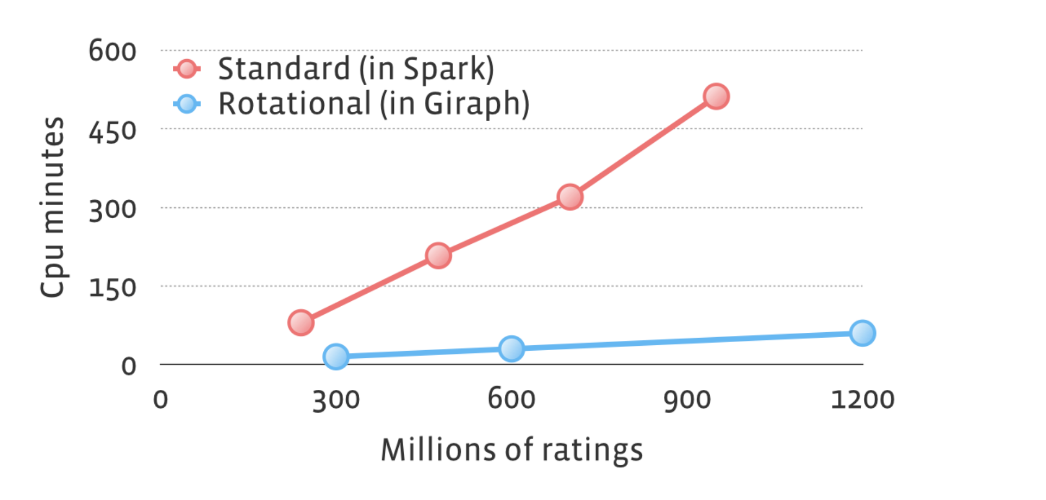
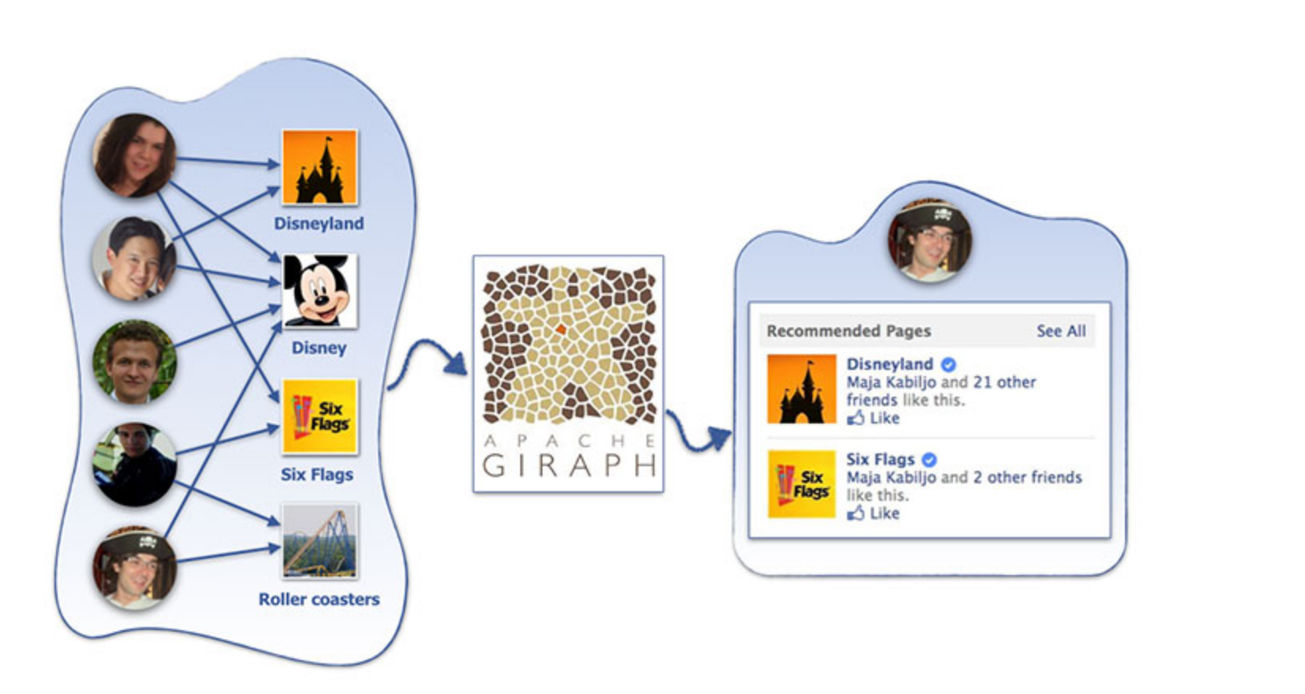
Hybrid approach using Giraph
Giraph is an open source Apache project
Large data set(in billions) was still a problem to be solved
Extended Giraph framework to customize behavior
Implemented Worker to Worker messaging for improved performance

Slide 8
Thank you
References: https://code.fb.com/core-data/recommending-items-to-more-than-a-billion-people/

